Slide 1
Pointers and Arrays (T)
Subject : COMP6047
ALGORITHM AND PROGRAMMING
Year : 2015

Slide 2
Learning Outcomes
At the end of this session, student will be able to:
Explain the concept of array data and pointer
(LO2 & LO3)

Slide 3
Sub Topics
Pointers and Arrays:
Pointer Definition
Pointer Concept
Pointer to Pointer
Array Definition
Array Initialization
Pointer Constant & Pointer Variable
Accessing Array
2 and 3 Dimensional Array
String Manipulation
Program Examples
Exercise
Review

Slide 4
Pointer Definition
Pointer is a variable that store the address of another variable
Syntax :
<type> *ptr_name;
Two operators mostly used in pointer : * (content of) and & (address of)
Example:
Initialize an integer pointer into a data variable:
int i, *ptr;
ptr = &i;
To assign a new value to the variable pointed by the pointer:
*ptr = 5; /* means i=5 */

Slide 5
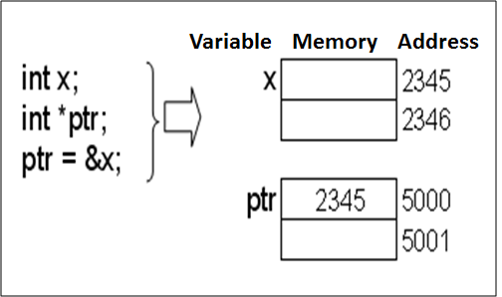
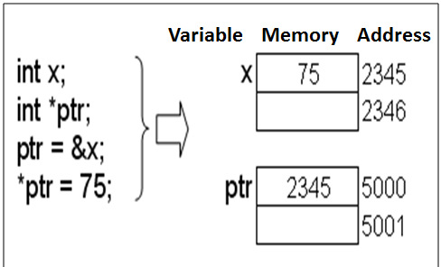
Pointer Concept

Slide 6
Pointer to Pointer
Pointer to pointer is a variable that saves another address of a pointer
Syntax:
<type> **ptr_ptr ;
Example:
int i, *ptr, **ptr_ptr;
ptr = &i;
ptr_ptr = &ptr;
To assign new value to i:
*ptr = 5; // means i=5 ;
**ptr_ptr = 9; // means i=9; or *ptr=9;

Slide 7
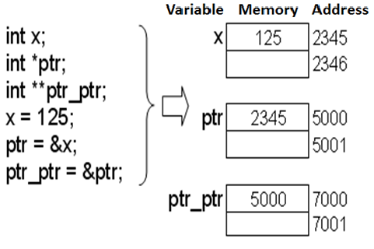
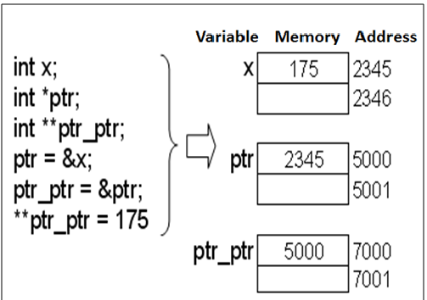
Pointer to Pointer

Slide 8
Array Definition
Data saved in a certain structure to be accessed as a group or individually. Some variables saved using the same name distinguish by their index.
Array characteristics:
Homogenous
All elements have similar data type
Random Access
Each element can be reached individually, does not have to be sequential

Slide 9
Array Definition (One Dimensional Array)
Syntax:
type array_value [value_dim];
Example :
int A[10];
The definition consists of 4 components:
Type specified
Identifier (name of the array)
Operator index ([ ])
Dimensional value inside operator [ ]

Slide 10
Array Definition
An illustration of array 1D
Elements of an array indexed starting from 0
A[0]
A[1]
A[2]
A[3]
A[4]
A[5]
A[6]
A[7]
A[8]
A[9]

Slide 11

Array Initialization
Array can be initialized explicitly without dimensional value declaration
Example:
int B[ ]={1, 2, -4, 8};
Array B has 4 elements
Example:
int B[8]={1, 2, -4, 8};

Slide 12
Array Initialization
Example: int B[4] = { 1, 2, -4, 8, 9 }; //error
error in result; smaller dimensional value
Example array initialization after definition:
int A[5];
(for i=0; i<5;i++) A[i]=0;
int B[5];
B[5]={0,0,0,0,0};
Error, why ?

Slide 13
Accessing Arrays
Two analogous ways of accessing an element i=2;
*(A+2) or A[2]
A is equivalent with &A[0] or a constant pointer to the first element of particular array
To show A[2] on the monitor screen:
printf(“%d”,A[2]) or
printf(“%d\n”,*(A+2));

Slide 14
Assigning Values
Assigning value to an element
Example : A[6] = 15; A[3] = 27;
Statement A[2] = A[3] - A[6], resulting:
27
15
A[0]
A[1]
A[2]
A[3]
A[4]
A[5]
A[6]
A[7]
A[8]
A[9]
12
27
15
A[0]
A[1]
A[2]
A[3]
A[4]
A[5]
A[6]
A[7]
A[8]
A[9]

Slide 15
Pointer Constant & Pointer Variable
Pointer variable is a pointer that can be assigned with new value at run-time.
Pointer constant is a pointer that can not be assigned with new value at run-time
Array is Pointer Constant to its first element of the array. Array can be filled with pointer variable.
Example:
int x=10, y=20;
int *ptr; //ptr is pointer variable
ptr = &x;
ptr = &y;

Slide 16
Pointer Constant & Pointer Variable
Example:
int x=10, y=20;
int B[4]; // B is an Array → pointer constant
int *ptr; // ptr is a pointer variable
ptr = &x; // ok
ptr = B; // ok
ptr++; // ok
B = ptr; // error
B++; // error
B = &y; // error
ptr = B; analogous with ptr = &B[0]; B is a pointer constant pointing to the first element of an array.

Slide 17
Pointer Constant & Pointer Variable
Pointer constant can only be initialized at definition time
Example:
int Arr1[10];
Arr1[10] = {1, 2, 3, 4, 5}; // error
Arr1 = {1, 2, 3, 4, 5}; // error
Arr1[10] = 12; // error max 9
Arr1[0] = 23; // ok
int Arr2[10] = {1, 2, 3, 4, 5}; //ok

Slide 18
Accessing Arrays
Accessing array using a pointer
int arr[10];
int *ptr_arr;
ptr_arr = arr; //or ptr_arr = &arr[0];
To access certain element can be done using:
ptr_arr[i];
arr[i];
*(ptr_arr + i);
*(arr + i);
ptr_arr = ptr_arr + i; *ptr_arr;

Slide 19
Array: Program Examples
Example:
#include <stdio.h>
void main()
{
int i;
int list_int[10];
for (i=0; i<10; i++){
list_int[i] = i + 1;
printf( "list_int[%d] init with %d.\n", i, list_int[i]);
}
}

Slide 20
One Dimensional Array
C compiler does not limit number of dimensional which can be created. Our PC memory does.
Example Array 1D:
#include<stdio.h>
int SIZE = 5;
void main() {
int i, j;
int n[SIZE] = {15, 9, 1, 7, 5};
for( i=0 ; i<= SIZE ; i++) {
printf("%5d ", n[i]);
for ( j=1; j<=n[i] ; j++) printf("%c","*");
printf("\n");
}
}

Slide 21
Two Dimensional Array
Syntax 2D Array:
type name_array[row][col];
Example:
int a[3][4];
Column 0
Column 1
Column 2
Column 3
Row 0
a[ 0 ][ 0 ]
a[ 0 ][ 1 ]
a[ 0 ][ 2 ]
a[ 0 ][ 3 ]
Row 1
a[ 1 ][ 0 ]
a[ 1 ][ 1 ]
a[ 1 ][ 2 ]
a[ 1 ][ 3 ]
Row 2
a[ 2 ][ 0 ]
a[ 2 ][ 1 ]
a[ 2 ][ 2 ]
a[ 2 ][ 3 ]
Column subscript
Array name
Row subscript

Slide 22
Two Dimensional Array
Initialization:
using rmo (row major order)
Example:
int b[2][2] = {1, 2, 3, 4 };
int b[2][2] = { { 1, 2 }, { 3, 4 } };
int b[2][2] = { { 1 }, { 3, 4 } };
int x[3][4] = {1, 2, 3, 4, 5, 6, 7, 8, 9, 10, 11, 12};
int x[3][4] = { {1, 2, 3, 4},
{5, 6, 7, 8},
{9, 10, 11, 12}
};
1 2
3 4
1 0
3 4

Slide 23
Two Dimensional Array
Example Array 2D:
/* Printing out array 2-D */
#include <stdio.h>
void main() {
int two_dim[3][5] = {1, 2, 3, 4, 5,
10, 20, 30, 40, 50,
100, 200, 300, 400, 500};
int i, j;
for (i=0; i<3; i++){
for (j=0; j<5; j++) printf("%6d", two_dim[i][j]);
printf("\n");
}
}
Output:
1 2 3 4 5
10 20 30 40 50
100 200 300 400 500

Slide 24
Three Dimensional Array
Syntax 3D Array :
type name_array[row][col][depth];
Example:
int x[3][2][4] = {{{1,2,3,4}, {5,6,7,8}},
{{11,12,13,14}, {15,16,17,18}},
{{21,22,23,24}, {25,26,27,28}}
};
void main() {
int x[4][3][5] = {{{1, 2, 3}, {0, 4, 3, 4}, {1, 2}},
{{9, 7, 5}, {5, 7, 2}, {9}},
{{3, 3, 5}, {2, 8, 9, 9}, {1, 2, 1}},
{{0}, {1}, {0, 1, 9}}
};
printf(“%5d”, x[2][1][3]);
}

Slide 25
Array of Pointer
An array filled with pointer/s
Syntax :
type *array_name [value_dim];
Example:
int i;
int *ptr[4];
int x=1, y=2, z=3, w=5;
ptr[0]=&x, ptr[1]=&y; ptr[2]=&z; ptr[3]=&w;
for(i=0;i<4;i++) printf("%d ",*ptr[i]);
Output : 1 2 3 5

Slide 26
Array of Character
Array filled with character/s
Syntax:
char array_name[value_dim];
Example:
char name[40];
char ss[20]={‘B’,’I’,’N’,’U’,’S’}; //20 elements
char ss[ ]= {‘B’,’I’,’N’,’U’,’S’}; // 5 elements

Slide 27
String
String is an array of character that ended with null character ( ‘\0’ or in ASCII = 0)
String constant or string literal is some characters written between double quote
Example: ”Welcome to Binus”
String constant type is pointer constant, thus can be assigned to an array of character :
Example :
char name[40] = ”Amir”; //ok
name = ”Amir”; // error name is a constant pointer
Name[40]= “Amir”; //error

Slide 28
String
A Constant String can be linked at compile-time:
”Hello,” ” world”
Similar to:
”Hello, world”
Example string initialization:
char s[ ] = ”BiNus”;
Similar to :
char s[ ] = {’B’,’i’,’N’,’u’,’s’,’\0’};
String as a data type does not known in C

Slide 29

Char vs String
Character in c written between single quote. Each uses one byte of computer memory
Example:
char ch=’A’;
char ch=65; //Ascii
char ch=0x41; //Ascii
String written in between double quote.
Similar

Slide 30
String Manipulation
In Standard Library Function (header file string.h) provides functions to manipulate string:
strlen()
Return a value of string length; excluded null char
strcpy(s1,s2)
Copy s2 to s1
strncpy(s1,s2,n)
Copy first n characters of s2 to s1
strcat(s1,s2)
Adding string s2 to the end of string s1
strncat(s1,s2,n)
Adding n characters of string s2 to the end of string s1
strcmp(s1,s2)
Comparing the value of string s1 and s2, if similar returning 0
etc.

Slide 31
Program Examples
Example: (String Manipulation)
char s1[ ] = “abcdef”;
char s2[ ] = “xyz”;
strlen(“nana”); // 4
strcmp(“nana”, “nana”) // result 0
strcpy(s1,s2); // s1 = “xyz”, s2 = “xyz”
strncpy(s1,s2,2); // s1 = “xycdef”, s2 = “xyz”
strncpy(s1,s2,4); // if n>=strlen(s2) similar with // strcpy() s1 = “xyz”
strcat(s1,s2); // s1=“abcdefxyz”, s2=“xyz”
strncat(s1,s2,2); // s1=“abcdefxy”, s2=“xyz”
s1 = “Happy”
s2 = “New Year”
strcat( s1, s2 ) // s1= “Happy New Year”
strncat( s3, s1, 6 ) // s1= “Happy”
strcat( s3, s1 ) // s1= “Happy Happy New Year”

Slide 32
Program Examples
Example: (Copy String)
/* Copy string */
#include <stdio.h>
#include <string.h>
void main() {
char str1[] = "Copy a string.";
char str2[15];
char str3[15];
int i;
strcpy(str2, str1); // with strcpy()
for (i=0; str1[i]; i++) // without strcpy()
str3[i] = str1[i];
str3[i] = `\0';
/* print out str2 and str3 */
printf("The content of str2: %s\n", str2);
printf("The content of str3: %s\n", str3);
}

Slide 33
Exercise
Create a program to get 10 integer values from keyboard and store in an array. Find out:
Max value inside the array
Min value inside the array
Calculate average value of the array
Show the result to the monitor
Create a program in C to:
Get a string from keyboard
Rotate those characters
Display the result
Example: input : KASUR
rotated : RUSAK

Slide 34
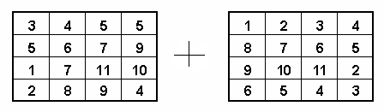
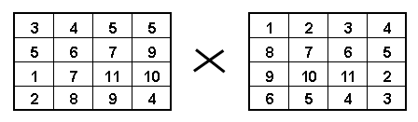
Exercise
Create a program of matrix addition. Use 2D array!
Create a program of matrix multiplication. Use 2D array!

Slide 35
Exercise
Given the following Arrays:
int A[3][4]={1, 3, 2, 4, 5, 7, 6, 8, 9,11, 12 };
int B[3][3]={{1, 2}, {3, 4, 5} ,{ 7 }};
What are the values of:
A[1][1] = ?
B[2][2] = ?
A[2][3] = ?
B[0][1] = ?
A[0][2] = ?

Slide 36
Exercise
Given the following statements:
char str[] = ”Welcome to Binus”;
char *str = ”Welcome to Binus”;
Compare and contrast the two str identifier described above!
Given the following statements:
char *name[] = {”Ali”,”Ani”,”Tono”};
char name[][10] = {”Ali”,”Ani”,”Tono”};
Compare and contrast the two name identifiers above !

Slide 37
Exercise
Describe some functions of <ctype.h>:
isalpha(int c);
isupper(int c);
islower(int c);
isdigit(int c);
isalnum(int c);
isspace(int c);
toupper(int c);
tolower(int c);

Slide 38
Summary
Pointer is a variable that store the address of another variable
Pointer to pointer is a variable that saves another address of a pointer
Data saved in a certain structure to be accessed as a group or individually. Some variables saved using the same name distinguish by their index which called as an array
String is an array of character that ended with null character

Slide 39
References
Paul J. Dietel,Harvey M. Deitel,. 2010. C : how to program. PEAPH. New Jersey. ISBN:978-0-13-705966-9 Chapter 6 & 7
C Programming – Pointers: http://www.exforsys.com/tutorials/c-language/c-pointers.html
Storing Similar Data Items: http://aelinik.free.fr/c/ch12.htm

Slide 40
END

